Slide 1
Lecture 21
I_{DDQ} Current Testing
Definition
Faults detected by I_{DDQ} tests
Vector generation for I_{DDQ} tests
  Full-scan
  Quietest
Instrumentation difficulties
Sematech study
Limitations of I_{DDQ} testing
Summary

Slide 2
Motivation
Early 1990’s – Fabrication Line had 50 to 1000 defects per million (dpm) chips
  IBM wants to get 3.4 defects per million (dpm) chips (0 defects, 6 σ)
Conventional way to reduce defects:
  Increasing test fault coverage
  Increasing burn-in coverage
  Increase Electro-Static Damage awareness
New way to reduce defects:
  I_{DDQ} Testing – also useful for Failure Effect Analysis

Slide 3
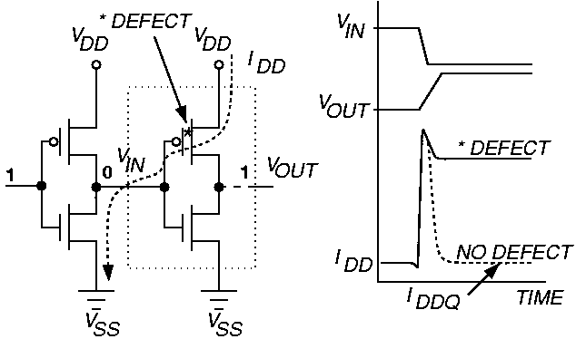
Basic Principle of I_{DDQ} Testing
  Measure I_{DDQ} current through V_{ss} bus

Slide 4
Faults Detected by I_{DDQ} Tests

Slide 5
Stuck-at Faults Detected by I_{DDQ} Tests
Bridging faults with stuck-at fault behavior
  Levi – Bridging of a logic node to V_{DD} or V_{SS} – few of these
  Transistor gate oxide short of 1 KΩ to 5 KΩ
Floating MOSFET gate defects – do not fully turn off transistor

Slide 6
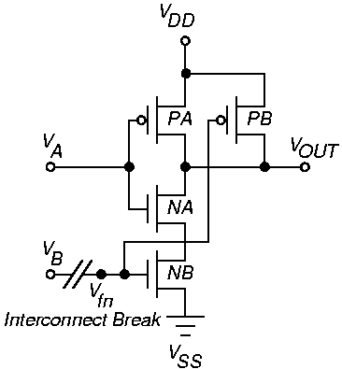
NAND Open Circuit Defect – Floating gate

Slide 7
Floating Gate Defects
Small break in logic gate inputs (100 – 200 Angstroms) lets wires couple by electron tunneling
  Delay fault and I_{DDQ} fault
Large open results in stuck-at fault – not detectable by I_{DDQ} test
  If V_{tn} < V_{fn} < V_{DD} - | V_{tp} | then detectable by I_{DDQ} test

Slide 8
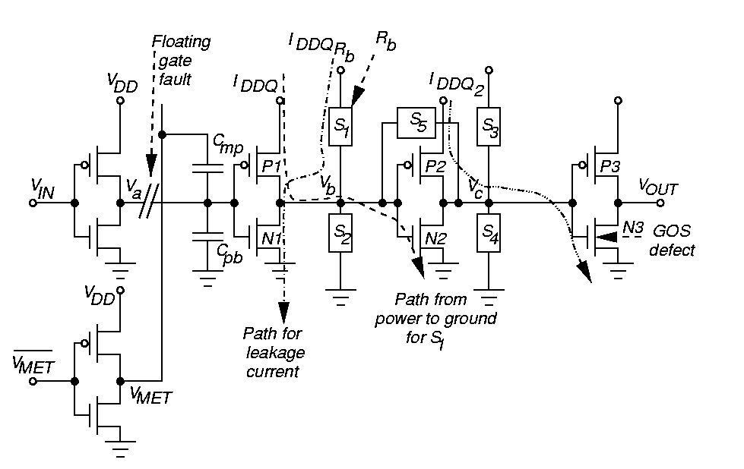
Multiple I_{DDQ} Fault Example

Slide 9
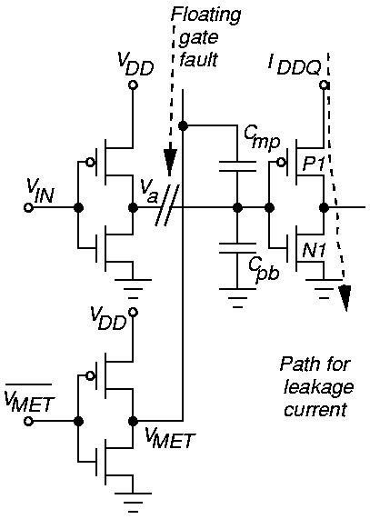
Capacitive Coupling of Floating Gates
C_{pb} – capacitance from poly to bulk
C_{mp} – overlapped metal wire to poly
Floating gate voltage depends on capacitances and node voltages
If nFET and pFET get enough gate voltage to turn them on, then I_{DDQ} test detects this defect
K is the transistor gain

Slide 10
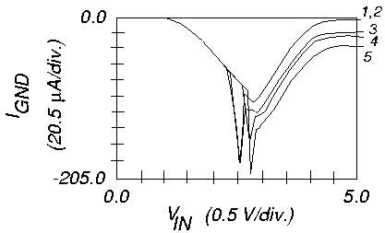
I_{DDQ} Current Transfer Characteristic
Segura et al. – 5 defective inverter chains
(1-5) with floating gate defects

Slide 11
Bridging Faults S₁ – S₅
Caused by absolute short (< 50 Ω) or higher R
Segura et al. evaluated testing of bridges with 3 CMOS inverter chain
I_{DDQRb} tests fault when R_{b} > 50 KΩ or 0 R_{b} 100 KΩ
Largest deviation when V_{in} = 5 V bridged nodes at opposite logic values

Slide 12
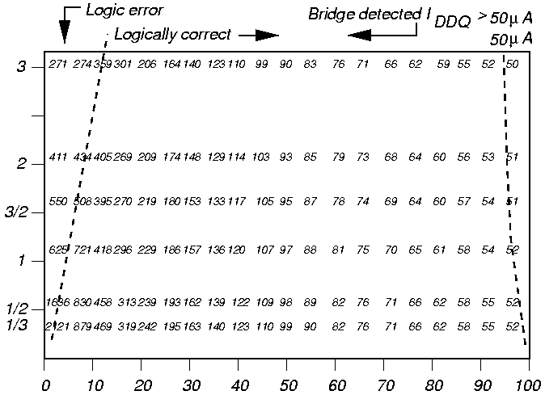
S1 I_{DDQ} Depends on K, Rb
|I_{DDQ}|
(μA)
K
Rb (kΩ)

Slide 13
CMOS Transistor Stuck-Open Faults
I_{DDQ} test can sometimes detect fault
  Works in practice due to body effect

Slide 14
Delay Faults
Most random CMOS defects cause a timing delay fault, not catastrophic failure
Many delay faults detected by I_{DDQ} test – late switching of logic gates keeps I_{DDQ} elevated
Delay faults not detected by I_{DDQ} test
  Resistive via fault in interconnect
  Increased transistor threshold voltage fault

Slide 15
Leakage Faults
Gate oxide shorts cause leaks between gate & source or gate & drain
Mao and Gulati leakage fault model:
  Leakage path flags: f_{GS}, f_{GD}, f_{SD}, f_{BS}, f_{BD}, f_{BG} G = gate, S = source, D = drain, B = bulk
Assume that short does not change logic values

Slide 16
Weak Faults
nFET passes logic 1 as 5 V – V_{tn}
pFET passes logic 0 as 0 V + |V_{tp}|
Weak fault – one device in C-switch does not turn on
  Causes logic value degradation in C-switch

Slide 17
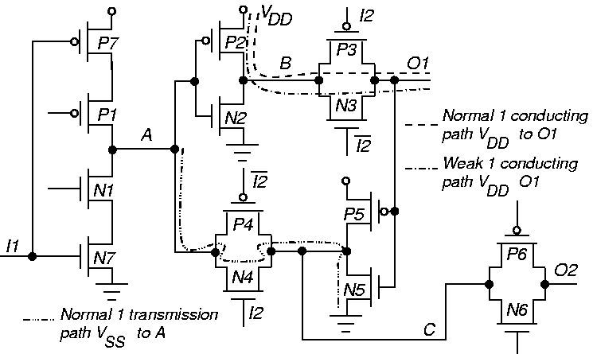
Paths in Circuit

Slide 18
Transistor Stuck-Closed Faults
Due to gate oxide short (GOS)
k = distance of short from drain
R_{s} = short resistance
I_{DDQ2} current results show 3 or 4 orders of magnitude elevation

Slide 19
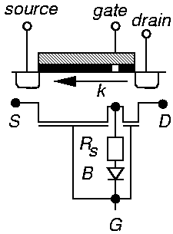
Gate Oxide Short

Slide 20
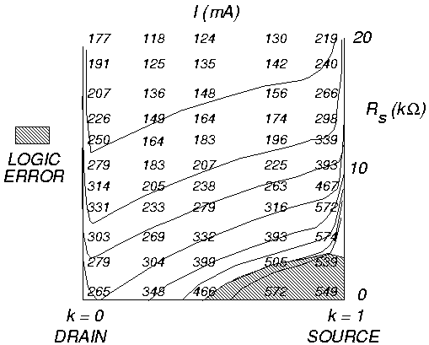
Logic / I_{DDQ} Testing Zones

Slide 21
Fault Coverage Metrics
Conductance fault model (Malaiya & Su)
  Monitor I_{DDQ} to detect all leakage faults
  Proved that stuck fault test set can be used to generate minimum leakage fault test set
Short fault coverage
  Handles intra-gate bridges, but may not handle inter-gate bridges
Pseudo-stuck-at fault coverage
  Voltage stuck-at fault coverage that represents internal transistor short fault coverage and hard stuck-at fault coverage

Slide 22
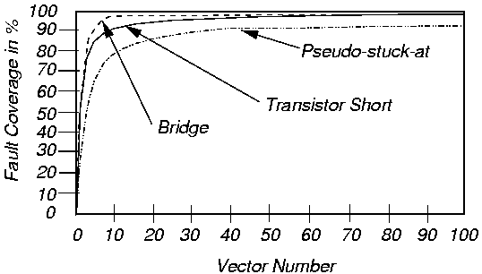
Fault Coverages for I_{DDQ} Fault Models

Slide 23
Vector Selection with Full Scan -- Perry
Use voltage testing & full scan for I_{DDQ} tests
Measure I_{DDQ} current when voltage vector set hits internal scan boundary
  Set all nodes, inputs & outputs in known state
  Stop clock & apply minimum I_{DDQ} current vector
  Wait 30 ms for settling, measure I_{DDQ} against 75 μA Limit, with 1 μA accuracy

Slide 24
Quietest Leakage Fault Detection – Mao and Gulati
Sensitize leakage fault
Detection – 2 transistor terminals with leakage must have opposite logic values, & be at driving strengths
Non-driving, high-impedance states won’t work – current cannot go through them

Slide 25
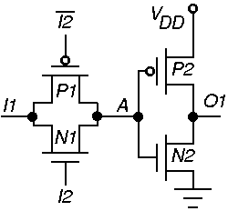
Weak Fault Detection – P1 (N1) Open
Elevates I_{DDQ} from 0 μA to 56 μA

Slide 26
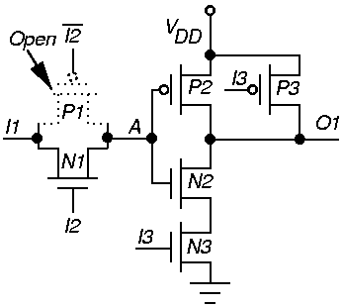
Second Weak Fault Detection Example
Not detected unless I3 = 1

Slide 27
Hierarchical Vector Selection
Generate complete stuck-fault tests
Characterize each logic component – relate input/output logic values & internal states:
  To leakage fault detection
  To weak fault sensitization/propagation
  Uses switch-level simulation
Store information in leakage & weak fault tables
Logic simulate stuck-fault tests – use tables to find faults detected by each vector
  No more switch-level simulation

Slide 28
Leakage Fault Table
k = # component I/O pins
n = # component transistors
m = 2^{k} (# of input / output combinations)
m x n matrix M represents the table
Each logic state – 1 matrix row
Entry m_{i j} = octal leakage fault information
  Flags f_{BG} f_{BD} f_{BS} f_{SD} f_{GD} f_{GS}
  Sub-entry m_{i j} = 1 if leakage fault detected

Slide 29
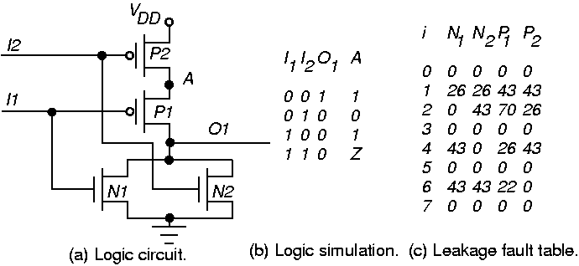
Example Leakage Fault Table

Slide 30
Weak Fault Table
Weak faults:
  Sensitized by input/output states of faulty component
  Propagated by either faulty component input/output states or input/output states of components driven by node with weak fault
Use weak fault detection, sensitization, and propagation tables

Slide 31
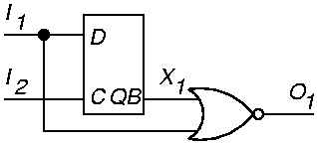
Quietest Results
If vector tests 1 new leakage/weak fault, select it for I_{DDQ} measurement
Example circuit:

Slide 32
Results – Logic & I_{DDQ} Tests
Time
99
199
299
399
499
599
699
I1
0
0
1
1
0
1
1
I2
1
0
0
1
1
1
0
X1
1
1
1
0
1
0
0
O1
0
0
0
0
0
0
0
Time
799
899
999
1099
1129
1299
1399
I1
0
0
1
1
0
1
1
I2
0
1
1
0
0
0
1
X1
0
1
0
0
0
0
0
O1
1
0
0
0
1
0
0
I_{DDQ} measurement vectors in bold & italics
Time in units

Slide 33
Quietest Results
Ckt.
1
2
# of
Tran-
Sistors
7584
42373
# of
Leakage
Faults
39295
220571
%
Selected
Vectors
0.5 %
0.99 %
Leakage
Fault
Coverage
94.84 %
90.50 %
Ckt.
1
2
# of
Weak
Faults
1923
1497
%
Selected
Vectors
0.35 %
0.21 %
Weak
Fault
Coverage
85.3 %
87.64 %

Slide 34
Instrumentation Problems
Need to measure < 1 μA current at clock > 10 kHz
Off-chip I_{DDQ} measurements degraded
  Pulse width of CMOS IC transient current
  Impedance loading of tester probe
  Current leakages in tester
  High noise of tester load board
Much slower rate of current measurement than voltage measurement

Slide 35
Sematech Study
IBM Graphics controller chip – CMOS ASIC, 166,000 standard cells
0.8 μm static CMOS, 0.45 μm Lines (L_{eff}), 40 to 50 MHz Clock, 3 metal layers, 2 clocks
Full boundary scan on chip
Tests:
  Scan flush – 25 ns latch-to-latch delay test
  99.7 % scan-based stuck-at faults (slow 400 ns rate)
  52 % SAF coverage functional tests (manually created)
  90 % transition delay fault coverage tests
  96 % pseudo-stuck-at fault cov. I_{DDQ} Tests

Slide 36
Sematech Results
Test process: Wafer Test Package Test
Burn-In & Retest Characterize & Failure Analysis
Data for devices failing some, but not all, tests.
IDDQ (5 μA limit)
pass
14
6
52
pass
pass
6
0
1
36
fail
fail
1463
34
13
1251
pass
fail
7
1
8
fail
pass
fail
pass
fail
pass
pass
fail
fail
Scan-based Stuck-at
Scan-based delay
Functional

Slide 37
Sematech Conclusions
Hard to find point differentiating good and bad devices for I_{DDQ} & delay tests
High # passed functional test, failed all others
High # passed all tests, failed I_{DDQ} > 5 μA
Large # passed stuck-at and functional tests
  Failed delay & IDDQ tests
Large # failed stuck-at & delay tests
  Passed I_{DDQ} & functional tests
Delay test caught delays in chips at higher Temperature burn-in – chips passed at lower T.

Slide 38
Limitations of I_{DDQ} Testing
Sub-micron technologies have increased leakage currents
  Transistor sub-threshold conduction
  Harder to find I_{DDQ} threshold separating good & bad chips
I_{DDQ} tests work:
  When average defect-induced current greater than average good IC current
  Small variation in I_{DDQ} over test sequence & between chips
Now less likely to obtain two conditions

Slide 39
Summary
I_{DDQ} tests improve reliability, find defects causing:
  Delay, bridging, weak faults
  Chips damaged by electro-static discharge
No natural breakpoint for current threshold
  Get continuous distribution – bimodal would be better
Conclusion: now need stuck-fault, I_{DDQ}, and delay fault testing combined
Still uncertain whether I_{DDQ} tests will remain useful as chip feature sizes shrink further

